Slide 1
Central Los Angeles Neighborhood Analysis
Jakhongir Khatamov
Coursera Capstone Project

Slide 2
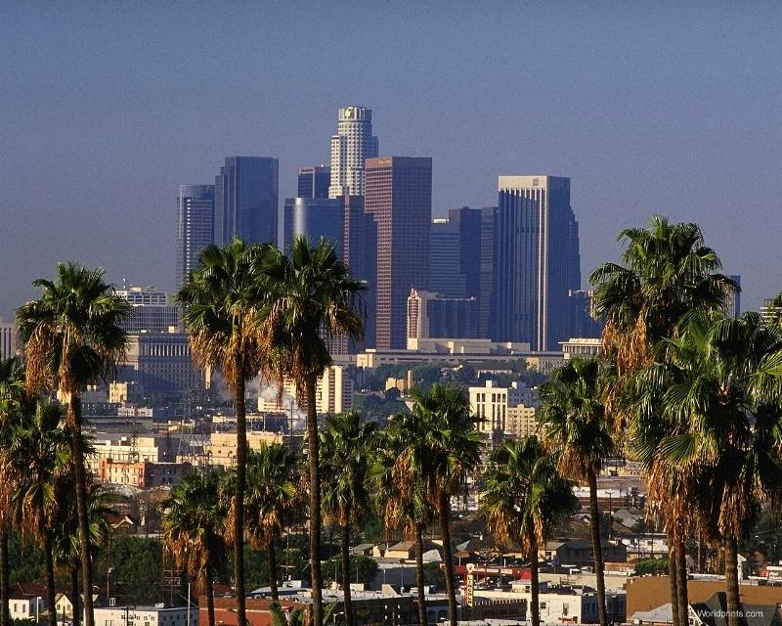
Introduction
Los Angeles (LA) is one of the biggest and most populous cities of the USA. Due to its Mediterranean climate, ethnic diversity and Hollywood entertainment industry, every year many people visit and enjoy all the benefits the city offers.
This Photo by Unknown Author is licensed under CC BY-NC-ND

Slide 3
Introduction
Travelers have some challenges and anxieties:
Which neighborhood should I live in?
How the rent prices differ across the neighborhoods?
Which neighborhood has more jobs that fit my skills and abilities?
There are 26 neighborhoods in central LA area
Arlington Heights
Beverly Grove
Carthay
Chinatown
Downtown
East Hollywood
Echo Park
Elysian Park
Elysian Valley
Faircrest Heights
Griffith Park
Hancock Park
Harvard Heights
Hollywood
Hollywood Hills
Hollywood Hills West
Koreatown
Larchmont
Los Feliz
Mid-City
Mid-Wilshire
Pico-Union
Silver Lake
West Hollywood
Westlake
Windsor Square
To answer this questions, I have conducted my own, analysis using spatial data and tools such as choropleth map, K-means clustering algorithm and Foursquare API.

Slide 4
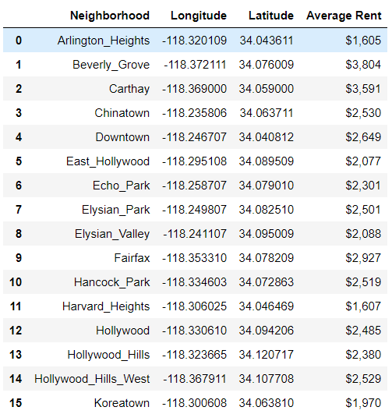
Data
Most of the data was obtained from the internet by scraping the web pages.
The following features was collected to do the analysis:
Latitude and longitude values of neighborhoods
Average rent price of neighborhoods
100 venues around each neighborhood
GEOJSON file was constructed using other source files

Slide 5
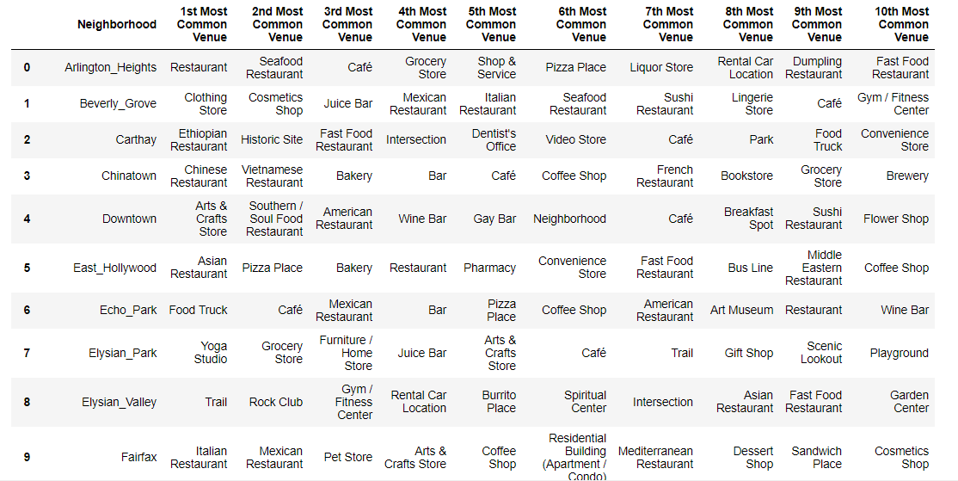
Methods
Top 10 venues for each neighborhood was extracted using Foursquare API.

Slide 6
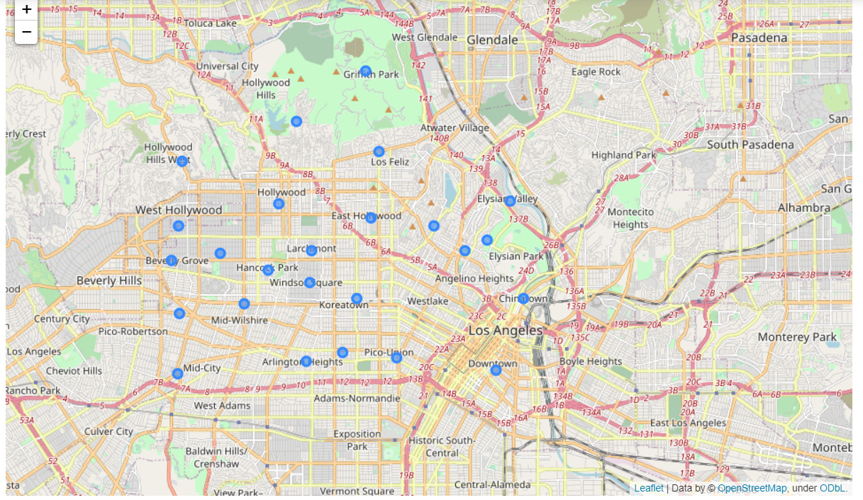
Methods
Python’s Folium package was used to initially visualize the neighborhoods.

Slide 7
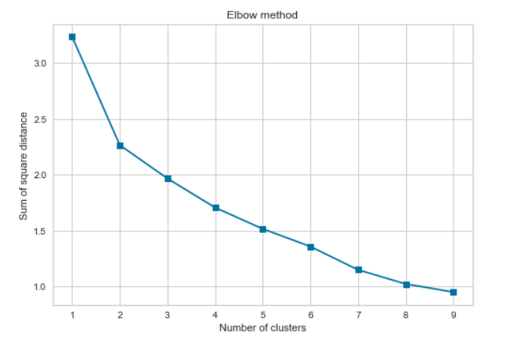
Methods
K-Means clustering algorithm was used to cluster the neighborhoods as well as
the elbow method to identify the appropriate number of clusters.
As we can see from the elbow method above, the sum of squares distance within the clusters does not decrease significantly after k = 3. Therefore, I have decided to generate three clusters.

Slide 8
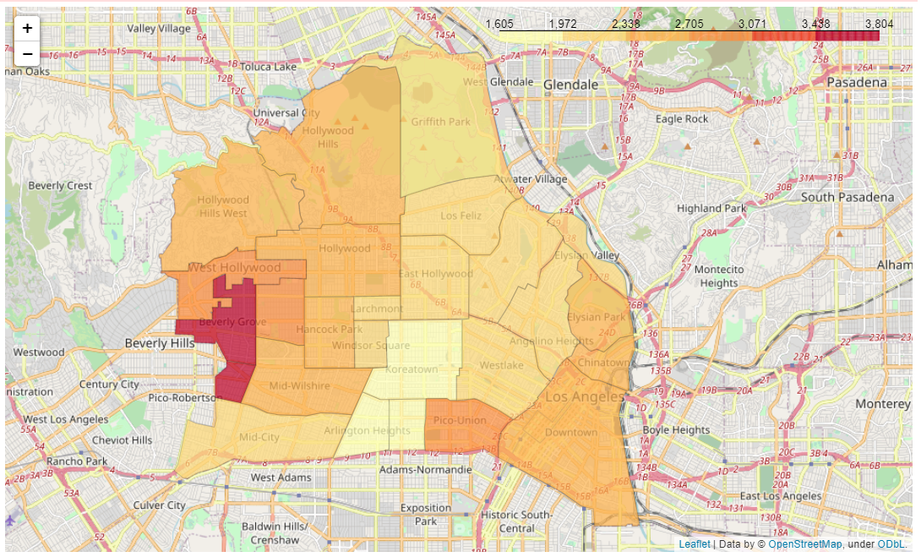
Results
Here is the choropleth map:
As we can see from the color bar, the darker the color the higher the average rent price in that neighborhood.

Slide 9
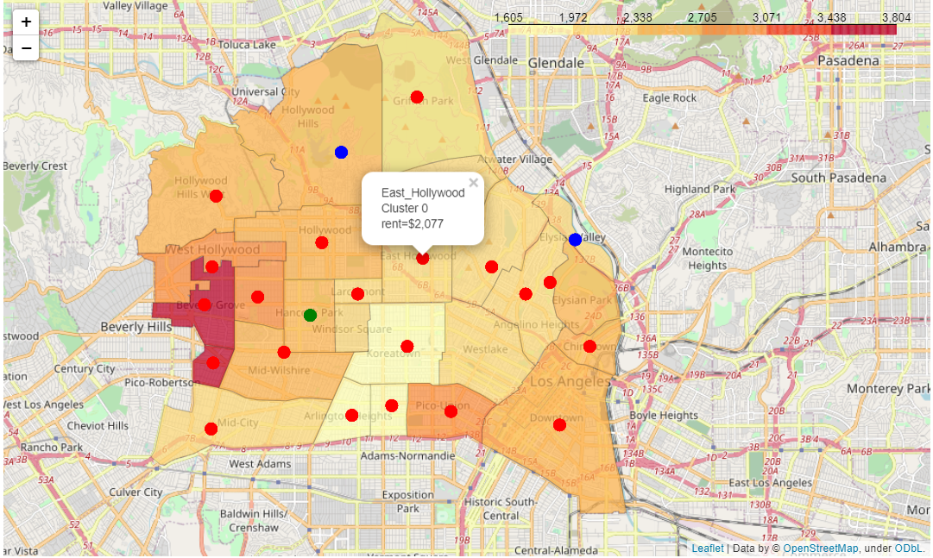
Results
The neighborhood clusters are superimposed on top of the choropleth map.
What is great about this map is that if you click on the circle markers which are the centers of the neighborhoods, they will display the name of the neighborhood, the category of cluster and the average rent price

Slide 10
Clusters
Cluster 1
Because it contains most of the neighborhoods, we can say that the central LA neighborhoods does not differ to much in terms of the venues they have. As we observed, most of the venues turned out to be the restaurants. Thus, if one has restaurant related skills and knowledge, then the central LA has a lot of jobs to offer.
Cluster 2
If one likes working out, doing physical exercise and tries living in a healthy lifestyle, then I would recommend living in neighborhoods that belong to cluster 2. This cluster has lots of trails and gym/fitness centers.
Cluster 3
This cluster seems to be suitable for those who like reading a lot because in this cluster they can find many bookstores.

Slide 11
Recommendations
The most affordable neighborhoods are Arlington Heights where the average rent is $1,605/month, Harvard Heights where renters pay on average $1,607/month on average and Koreatown where the average rent is $1,970/month.
The most expensive neighborhoods turned out to be Carthay where the average rent is $3,591/month and Beverly Grove where renters pay $3,804/month on average.
Another interesting fact is that the neighborhoods that are located on the eastern part of the area are relatively cheaper than those that are located on the western part.
Finally, for travelers and guests who want to stay or live in central LA, I would recommend living either in Arlington Heights or in Harvard Heights or in Koreatown. These three neighborhoods are much cheaper than others and the same time they do not differ significantly from other neighborhoods in terms of the type of venues and jobs they have.

